Slide 1


Simulating Agent Behavior Using Reinforcement Learning
Presenting:
Nir Sassy& Ofer Drori
Supervisor:
Dr. Ben Engelhard Engelhard Lab, Technion’s Medical Faculty

Slide 2
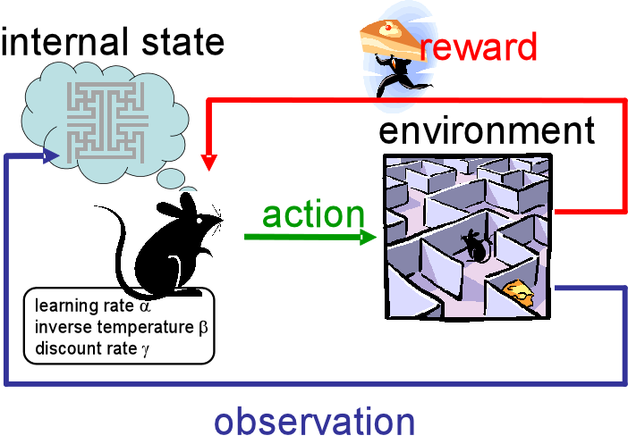
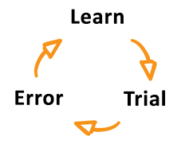
What Is Reinforcement Learning ?
Introduction
Goal
Methods
Results
Summary
Reinforcement Learning (RL) is a machine learning training method that is used to train an ‘agent’ to take optimal actions to maximize his rewards.
The reward system is based on the environment. For example, solving a maze would grant a positive reward, whereas reaching a ‘dead end’ would result in a negative result.
The agent learns solely from interacting with the environment and does not rely on training data like classic machine learning methods.

Slide 3
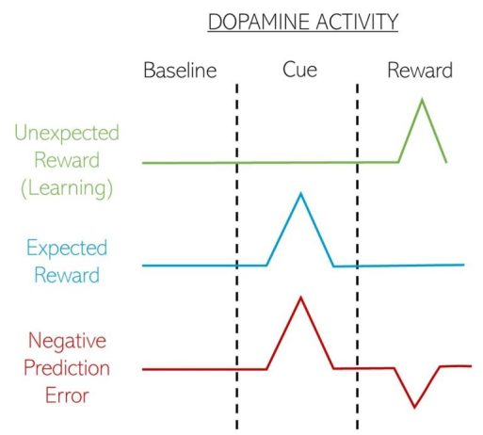
Dopamine as Reward Learning Signal
Introduction
Goal
Methods
Results
Summary
Dopamine secretion signals positive outcomes in biological learners, therefore guiding their decision-making processes.
According to the reward prediction error hypothesis, dopamine neurons encode the difference between expected and actual reward, called Temporal Difference, a similar difference used in a variety of loss functions in Reinforcement Learning Algorithms.

Slide 4

Biological Learning and Reinforcement Learning
Introduction
Goal
Methods
Results
Summary
RL algorithms were inspired by biological reward learning principles.
Biological learning is based mainly on rewarding the learner through the dopamine pathway in the brain.
What algorithm does the brain use?

Slide 5
Project goal
Introduction
Goal
Methods
Summary
Results
Extract learning signals from RL agents trained using various algorithms for comparison with biological learning signals

Slide 6
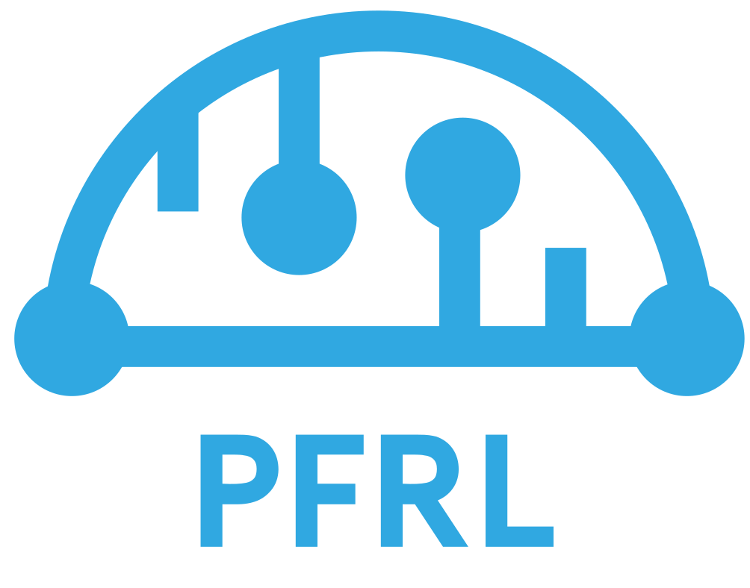
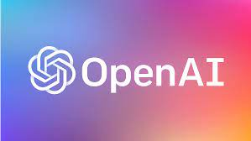
Methods
Introduction
Goal
Methods
Results
Summary
OpenAI’s open source PFRL library.
Python programming
RL Algorithms

Slide 7
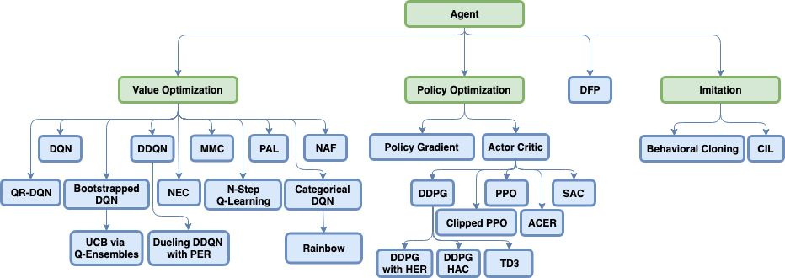
Reinforcement Learning Algorithms
Introduction
Goal
Methods
Results
Summary
In reinforcement learning there is a verity of algorithms and approaches.
Value-Based Optimization algorithms aims to maximize the long-term rewards for taking specific action for given state
Policy-Based Optimization algorithm directly optimize the mapping of states to actions in order to maximize the cumulative reward over the trajectory

Slide 8
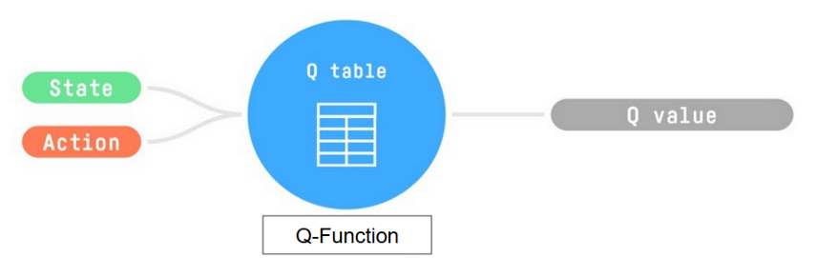
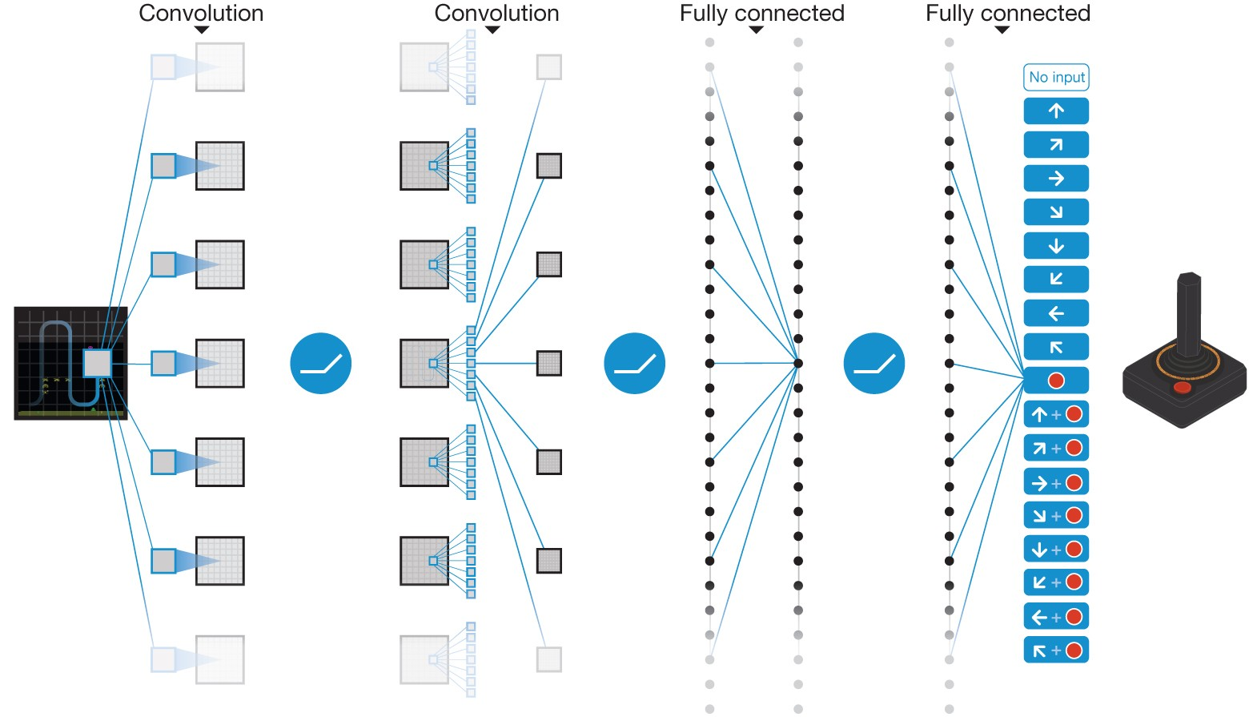
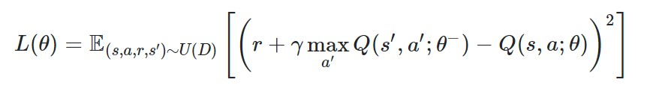
Deep Q Learning Network
Introduction
Goal
Methods
Results
Summary
Q learning is a Value-Based RL algorithm that learns the Q-function – a function that maps State-Action pairs to their value (Q). In short, the value represents how ‘good’ is a particular state-action pair.
DQN (Deep Q-learning Network) is a Q-learning algorithm that aims to approximate the Q-function through a deep neural network.
The learning is done by optimizing a loss function called the Bellman Error, which, in short, is the Temporal Difference (The error between the predicted Q value and the actual Q value)
Mnih, V. et al. 2015

Slide 9
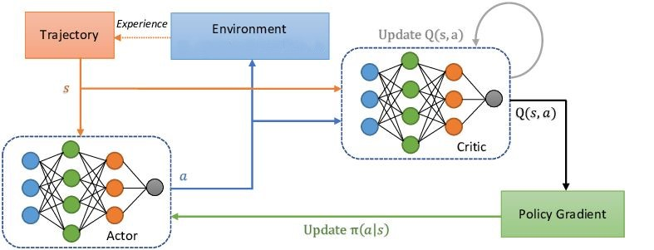
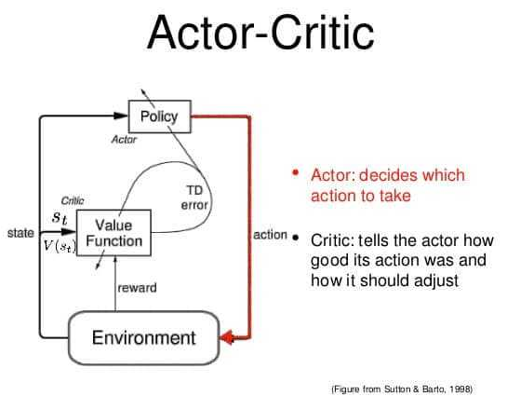
Proximal Policy Optimization
Introduction
Goal
Methods
Results
Summary
PPO (Proximal Policy Optimization) algorithm is a Policy-Based ‘Actor-Critic’ algorithm that is used to approximate the policy - a function that maps states to actions.
The agent (or the ‘actor’) collects experiences, which are [State, Action, Reward] combinations, trying to maximize the critic’s estimate.
The Critic is used (in the training phase alone) to evaluate the Actor performances and using these evaluations to update the policy in a global manner.

Slide 10
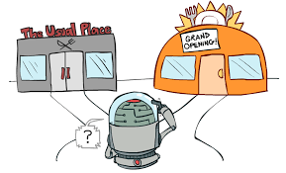
Exploration – Exploitation Trade Off
Introduction
Goal
Method
Result
Summary
In RL, the agent needs to explore its environment in order to gather information about the reward of different actions in different states. When he obtains some knowledge, he starts to adjust the trade off between exploring and exploiting the environment.
The exploration – exploitation trade off is a critical aspect in RL, but also for biological learners. Even when we find good and rewarding paths in life, maybe other paths present even more reward?
“Two roads diverged in a wood, and I— I took the one less traveled by, and that has made all the difference.”- The Road Not Taken, Robert Frost

Slide 11
Results
Introduction
Goal
Methods
Results
Summary
We trained RL agents on numerous tasks and extracted their learning signals.
Those signals will make a baseline for comparison with biological learning signals in the future.
We also sat a framework for conducting RL experiments - training and evaluating agents using vast RL algorithms on a variety of tasks.

Slide 12
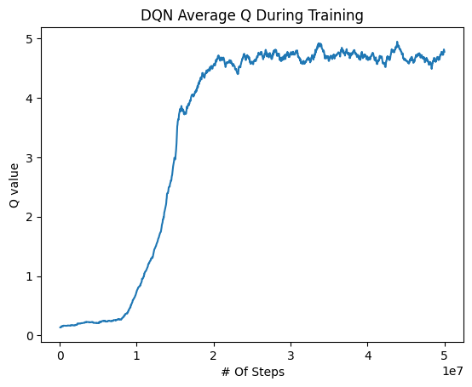
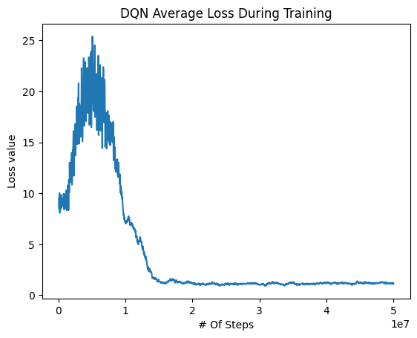
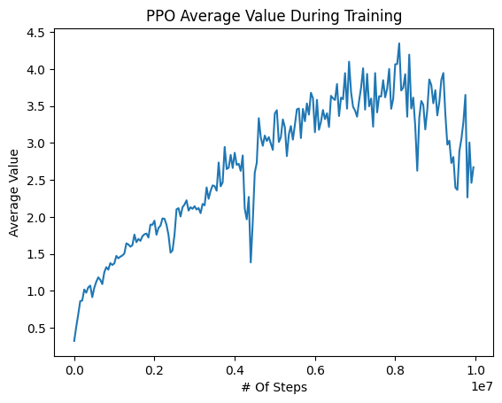
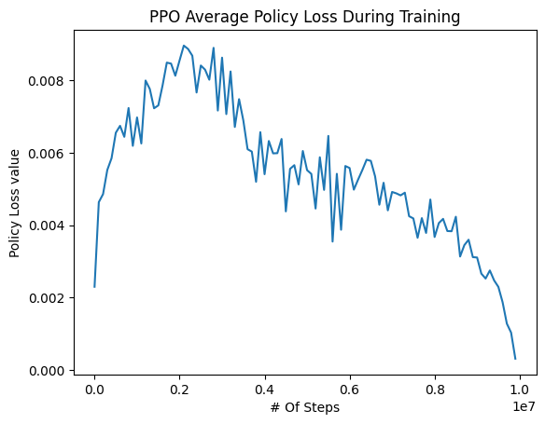
Introduction
Goal
Methods
Results
Summary
Learning Signals– PPO and DQN Agents (Atari Breakout)

Slide 13
Summary
Introduction
Goal
Methods
Results
Summary
Deep RL algorithms try to mimic the principles of biological learners, and by that make optimal decisions in a variety of environments.
Trained RL agents and improved their decision-making ability in various tasks
Extracted artificial learning signals from the agents we trained.

Slide 14

Acknowledgements
Dr. Ben Engelhard
Rotem Shapira
Guy Sassy (A.I Researcher – ECE, Technion)
Uriel Nusbaum (Algorithms Developer – Elbit)
Behrooz Omidvar-Tehrani (Contributor for PFRL library)

Slide 15
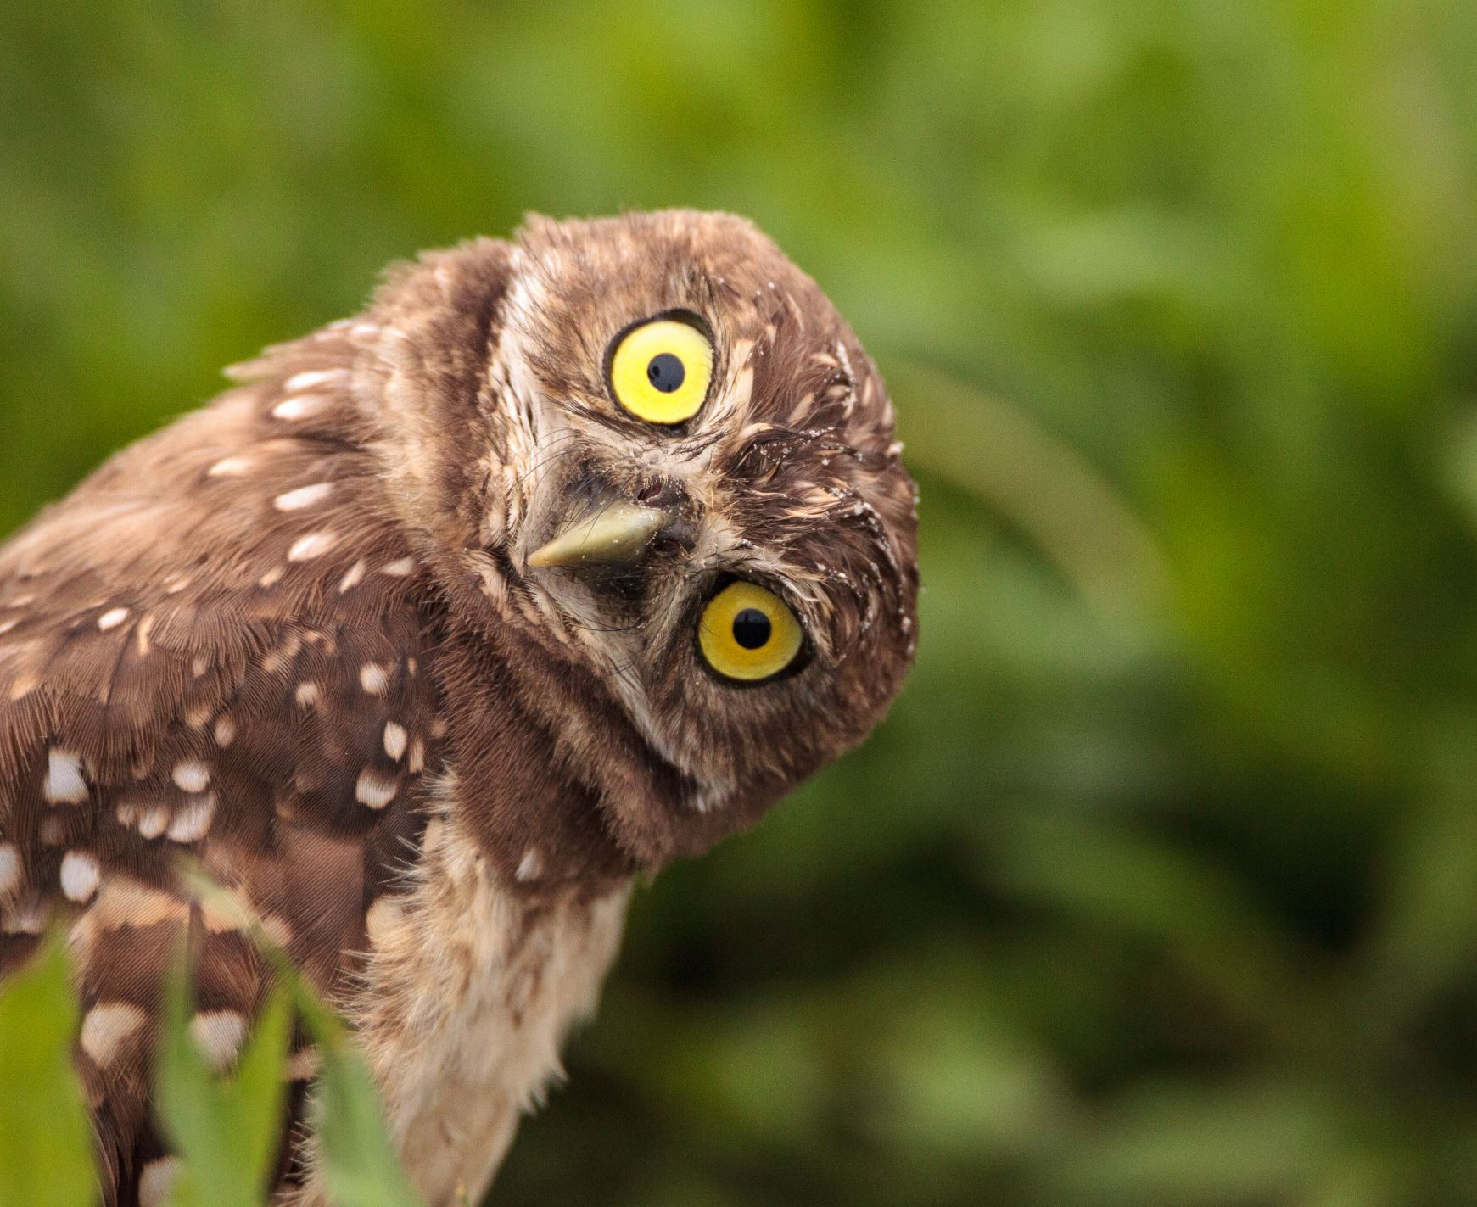

Questions?

